Slide 1
BI dimensionality
Advanced topics

Slide 2
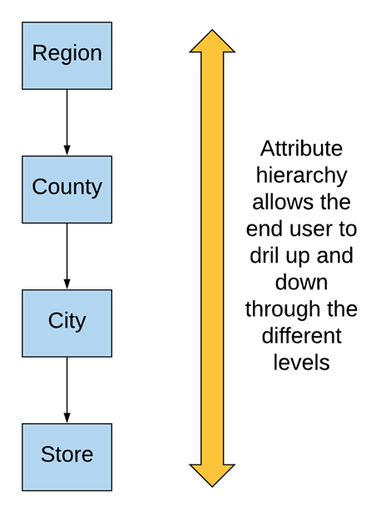
Attribute Hierarchies
Provides a top-down organisation of the data
Provides the capability to perform drill-down and roll-up searches in a data warehouse.

Slide 3
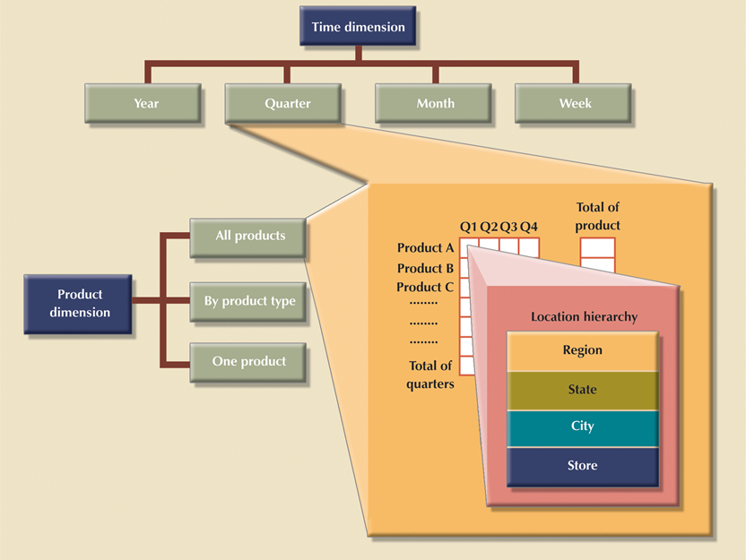
Balanced
Hierarchies

Slide 4
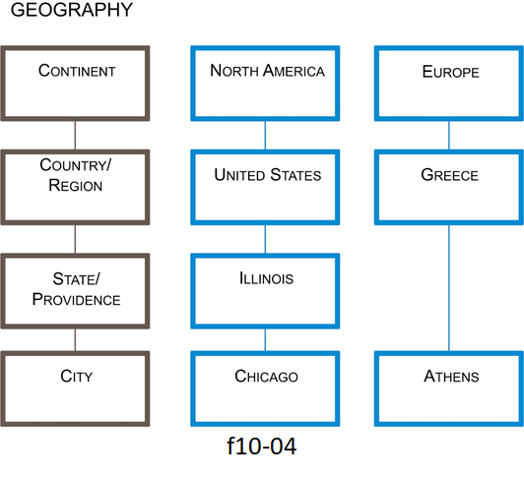
Ragged hierarchies

Slide 5
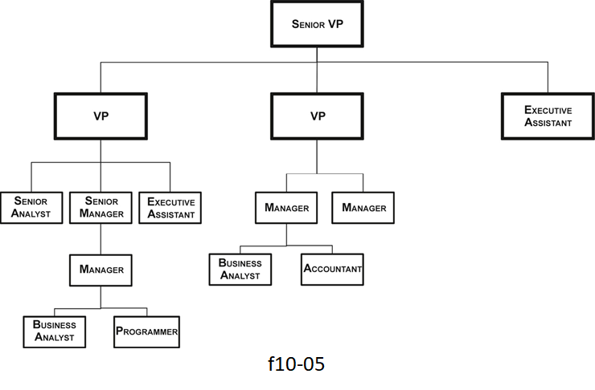
Unbalanced hierarchies

Slide 6
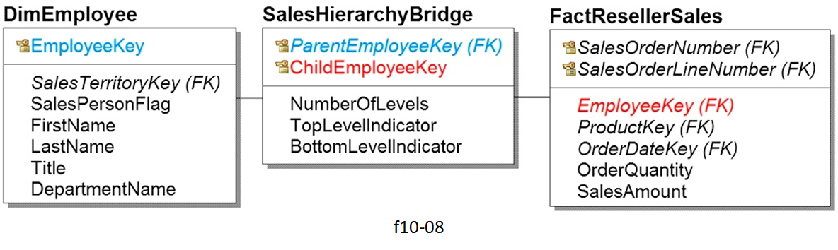
Bridge tables

Slide 7
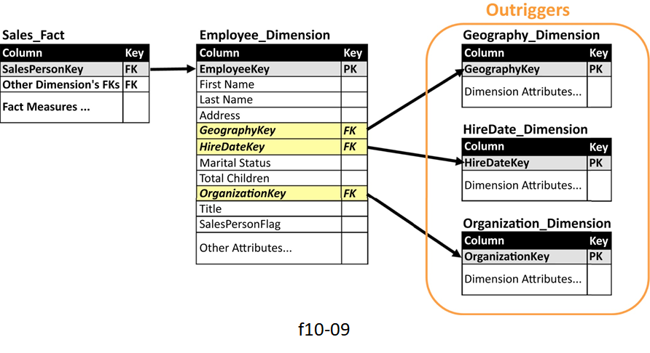
Outrigger tables

